Slide 1
Operating System
Operating system

Slide 2
Revision Operating system

Slide 3
Operating System Tasks
Operating System
Memory Management
Security Management
Process management
Hardware Management
File Management

Slide 4
How the OS Manges Resources?
Each program running on a computer is known as a process.
The OS manages how software processes share the system’s resources.
Example
Almost all software needs to save data to a storage device, such as a hard disk.
Imagine that there are three processes running at the same time, and all three processes save data regularly.
The processes might send requests to save data when the storage device is already in use. The operating system should manage these requests so that all three processes can save data.

Slide 5
How the OS Manges Resources?
The operating system share out processing time between all the processes. To do this, the OS runs a scheduler to swap between processes as required. The scheduler operates based on a scheduling algorithm, which determines:
How the processing time will be divided
The order the processes will be allocated processing time
How interrupts are handled

Slide 6
How the OS User Interface hides the hardware complexities from the user
The OS hides the hardware’s complexity by providing a user friendly interface and controlling the system’s resources so the user has a better experience.
Using GUI interfaces rather than CLI
Using device drivers (which simplifies the complexity of hardware interfaces)
Simplifying the saving and retrieving of data from memory and storage devices
Carrying out background utilities, such as virus scanning which the user can ‘leave to its own devices’
The organization of the storage media on the computer using the file allocation table
System files are hidden from us we do not have to know very advance computer coding knowledge for we to view them.

Slide 7
Different ways the OS hides details from the User
The organization of the storage media on the computer. The logical organization as we see it need not reflect the actual organization "behind the scenes. E.g the hard disk. The different drives are given letter so its easy for the user to know the drives and use the hardware
The use of the File Allocation Table, all the various pointers and addresses, the fragmented nature of files, and so on.
There are many System files themselves which are hidden from us, and we have to know very advance computer coding knowledge for we to view them.

Slide 8

Operating System -Process Management
Most personal computers are used to perform a variety of tasks using the same operating system. When a computer is running hundreds of processes are all loaded at the same time.
The operating system needs to switch between tasks so that the user can run multiple applications concurrently.
Most modern computers use a multitasking operating system where it can switch between tasks quickly to make it look like more than one task is running at a time.

Slide 9
Process scheduling
Types
High-level scheduler controls the selection of a program stored on disk to be moved into main memory.
Decides which processes are loaded from backing store
Into memory/ready queue
Low-level scheduler controls when the program installed in the memory has access to the CPU
Decide which process should next get the use of CPU time
Based on position/priority
Invoked after interrupt/OS call
Purpose: ensure response time is acceptable and the system remains stable at all times.

Slide 10
Why the operating system needs to use scheduling algorithm
To allow multitasking to take place
To ensure fair usage of the processor, peripheral, and memory
To ensure high priority tasks are executed sooner
To ensure all processes have the opportunity to finish
To keep CPU busy all the time
To service largest amount of job in a given amount of time
To minimize the time user must wait for their result

Slide 11
Process Control Blocks (PCB)
A process control block (PCB) is a data structure which contains all of the data needed for a process to run; this can be created in memory when data needs to be received during execution time.
These are stored in what is called a Process Control Block (PCB).
The PCB will store:
current process state (ready, running or blocked)
process privileges (such as which resources it is allowed to access)
register values (PC, MAR, MDR and ACC)
process priority and any scheduling information
the amount of CPU time the process will need to complete
a process ID which allows it to be uniquely identified.

Slide 12
The State of a Process in the Operating System
A program is a written code and it is static whereas a process can be defined as ‘a program that is being executed’. (It referred to as dynamic.
The state of a process in an operating system can be described as what the process is currently doing or which phase it is in
As a process executes, it changes state. The state of a process is defined in part by the current activity of that process.
A process can be in three states.
Running: This is where the process is currently being executed by the processor
Ready: This is where the process is loaded into memory, ready to be executed.
Blocked: This is where the process is waiting for an event to occur before it is processed.

Slide 13
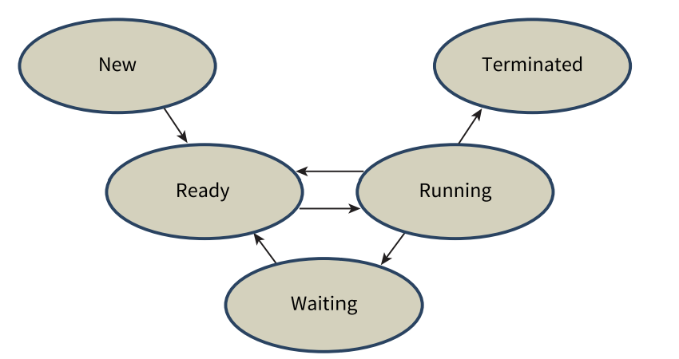
The transitions between the states
When a new process arrives in memory a PCB is created, it then changes to the ready state.
When a process in the ready state is access to the CPU by the dispatcher, it changes to the running given state.
If a process in the running state is halted by an interrupt; it returns to the ready state.
The process now in the running state cannot progress until some event has occurred then it will change to the waiting state (sometimes called the ‘suspended’ or ‘blocked’ state).
When a process in the waiting state is notified that an event is completed, it returns to the ready state.
A process in the running state completes execution; it changes to the terminated state.

Slide 14

CPU Scheduling
An operating system needs to use scheduling algorithm to manage the processes to be executed.
These algorithms allow multiprogramming /multitasking to take place.
They ensure fair usage of the processor, memory and peripheral devices.
They make sure that higher priority tasks are executed sooner and they that all processes have the opportunity to finish.

Slide 15
Scheduling Algorithms
First Come First Serve (FCFS)
Shortest Job First (SJF)
Shortest Remaining Time First (SRTF)
Round Robin

Slide 16
Types of Scheduling algorithm
There are four different scheduling routine algorithms:
1. First Come First Serve (FCFS)
2. Shortest Job First (SJF)
3. Shortest Remaining Time First (SRTF)
4. Round Robin

Slide 17
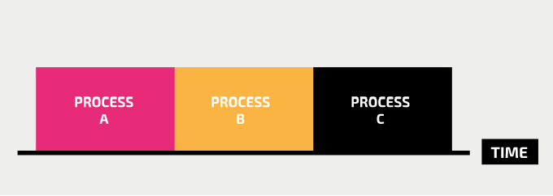
First Come First Serve (FCFS)
First come, first served scheduling, processes run from start to finish in the order in which the processor receives their request to run.
You could compare the first come, first served scheduling algorithm to a queue at a supermarket till — customers are served in the order in which they arrive at the till.
This is the simplest method to implement. Once a job starts, it will definitely complete.
With other scheduling algorithms, starvation may occur
starvation is when a process cannot complete its execution because it is constantly denied processor time.
When the processes run in the order in which the processor receives their request, there can be a long wait before a process can run. This work well only in a system that has a few concurrent processes.

Slide 18
Shortest Job First
Processes are queued and the process that needs the shortest total time to complete goes first.
You could compare this a supermarket queue in which the person with the fewest items in their basket is allowed to pay for their goods first.
This reduces wait times because shorter processes are removed quickly, which means that the processor can allocate more time to longer jobs.
However, this type of scheduling is susceptible to starvation if shorter jobs keep being added; the scheduler will keep prioritising these jobs, which means that longer processes will not be serviced.

Slide 19
Shortest Time Remaining
In shortest time remaining scheduling, the processes with the shortest time to completion go first, until a different task is added with a shorter time to completion, which then takes priority.
This is different to the shortest job first algorithm because a long job which is mostly complete might have a very short time remaining, and would therefore be prioritised.
Like shortest job first scheduling, this algorithm also has the effect of delaying longer processes from completing sooner if shorter processes are added in the meantime. The less a process has left to do, the higher priority it becomes.

Slide 20
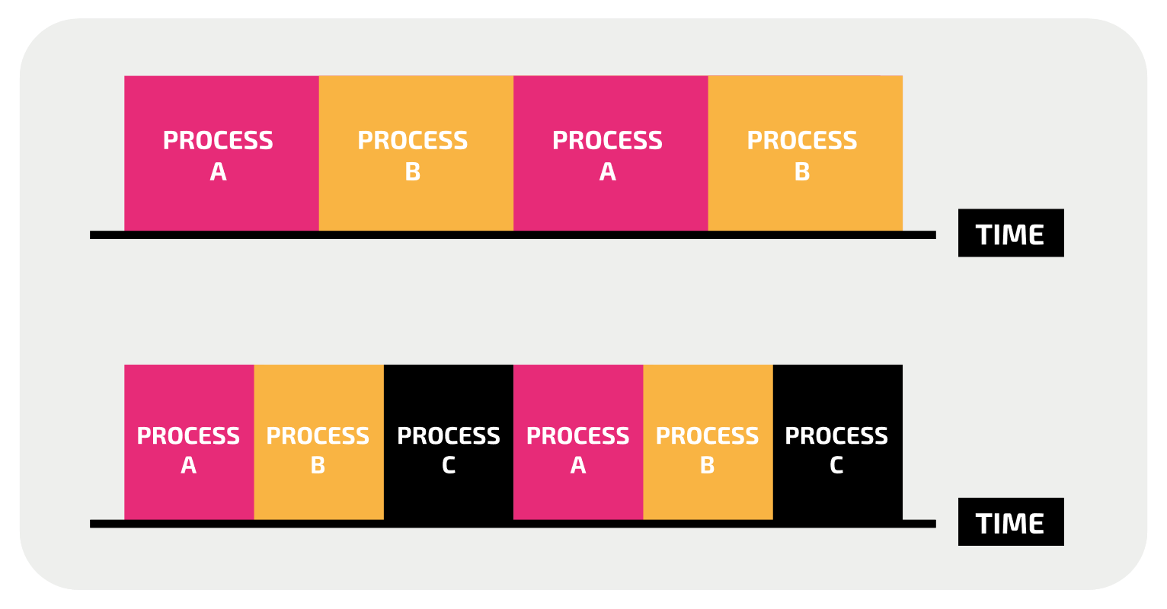
Round Robin Scheduling
In round robin scheduling, processor time is divided equally among all running tasks.
Each time period is called a time slice
Each process gets a time slice, and if the process has not finished when this time is up, it stops running and the computer switches to the next process. The process that has been suspended will only be able to resume running when it is next allocated processor time.
Round robin scheduling ensures that every task is allocated processor time without a long wait.
It does not scale well, because as more processes run, the time slice for each process gets smaller, which means that more urgent tasks are less likely to be completed quickly.

